Slide 1
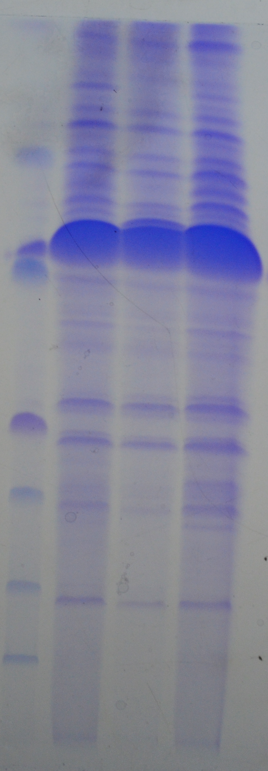
R1
R2
R3
Supplementary Figure 1. Analysis of 1-D SDS-PAGE of the spinach proteins. Proteins extracted from three biological replicates were resolved in 12.5% polyacrylamide gel followed by CBB R-250 staining. R1-3, three biological replicates.

